Slide 1

The Kols Grocery shopping application

Slide 2
Development/build process
Challenges
Time
Scope of the application
Building something that is not too simple and not too complicated
Building with the right coding conventions
Ethical Issues
Coles replica

Slide 3
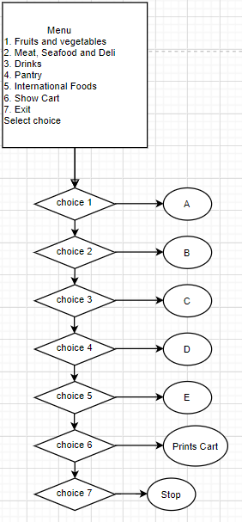
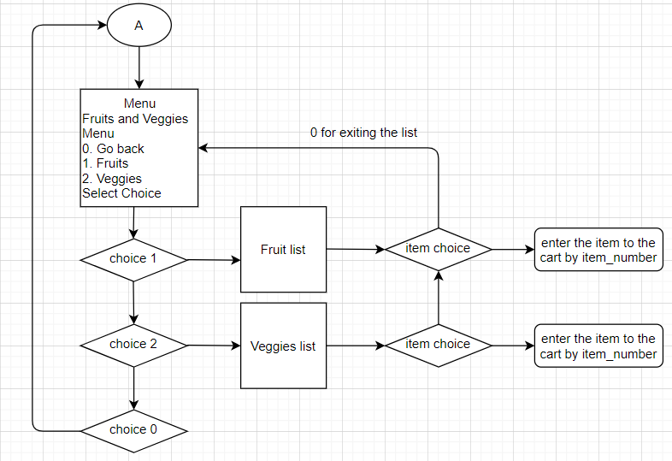
Logical flow of the application

Slide 4
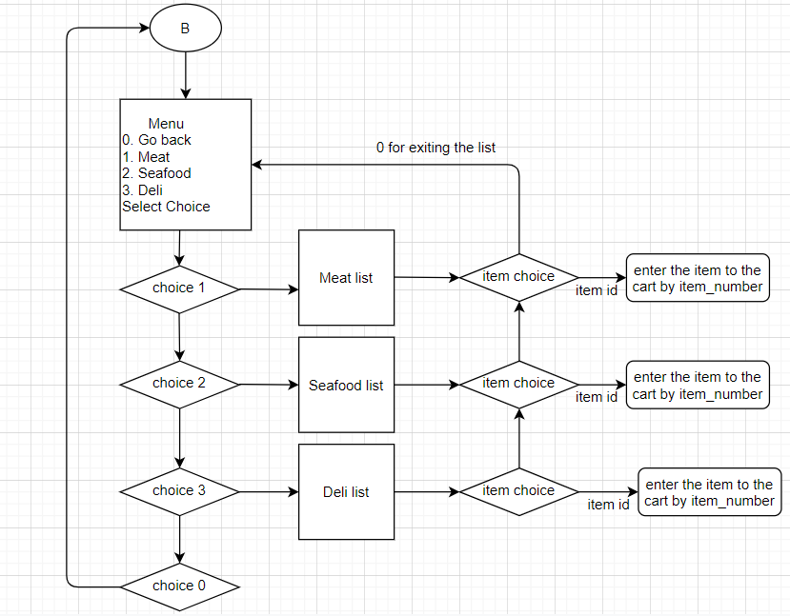
Logical flow of the application

Slide 5
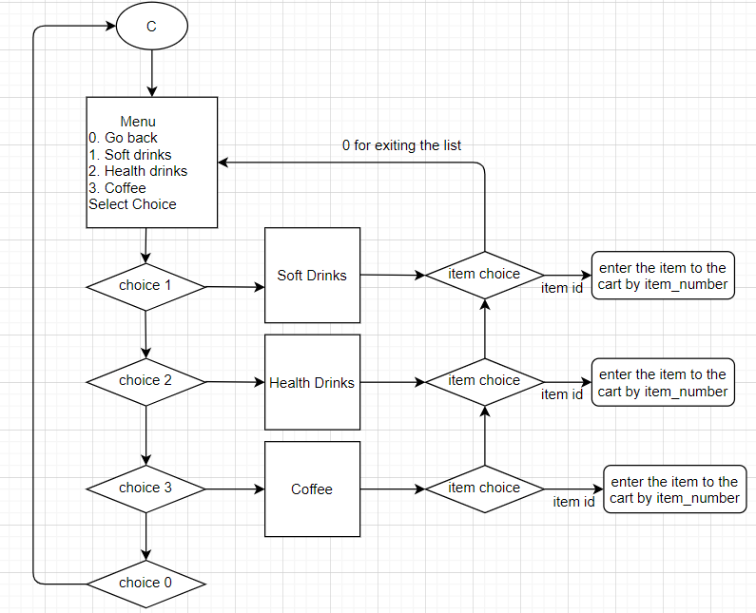
Logical flow of the application

Slide 6
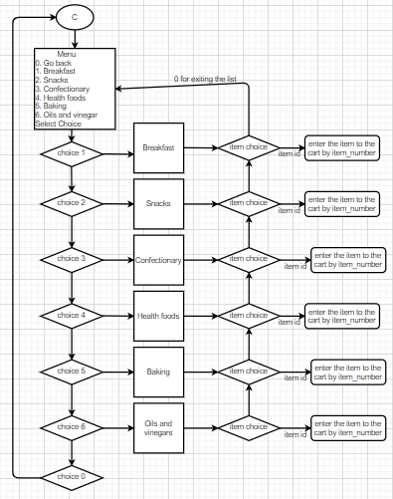
Logical flow of the application

Slide 7
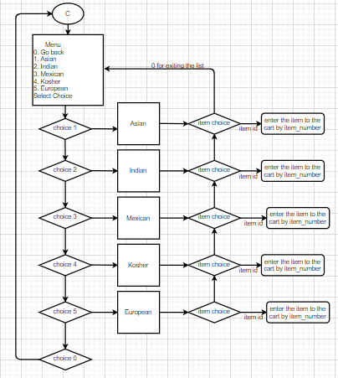
Logical flow of the application

Slide 8
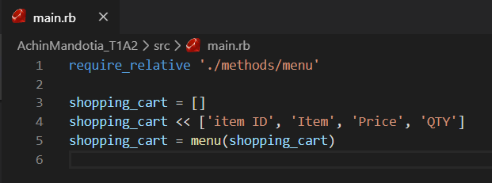
Application Structure

Slide 9
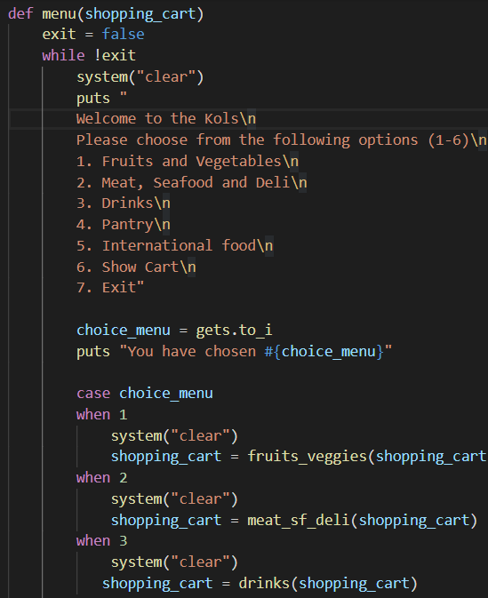
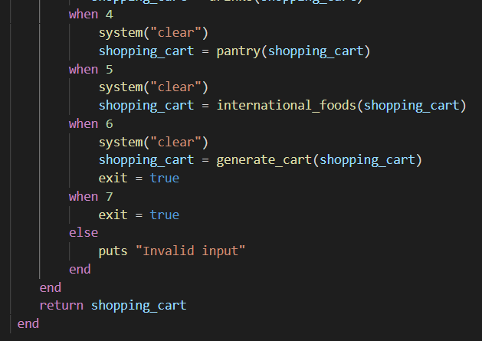
Application Structure

Slide 10
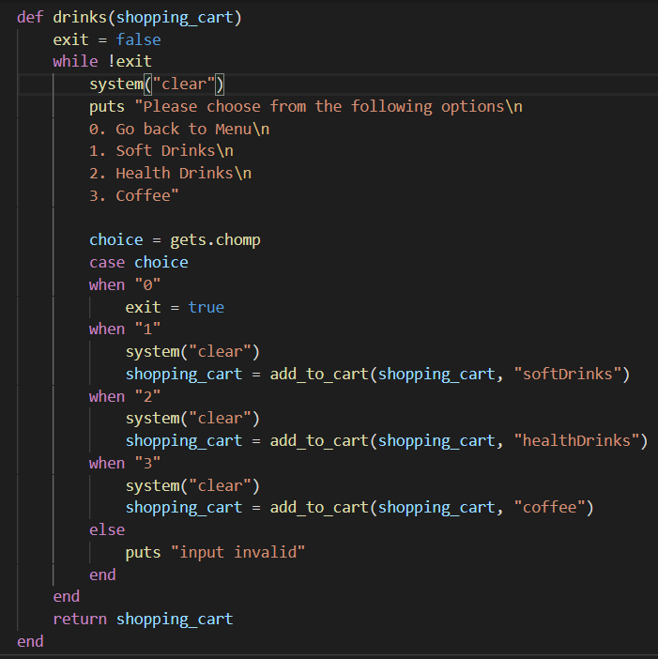
Application Structure

Slide 11
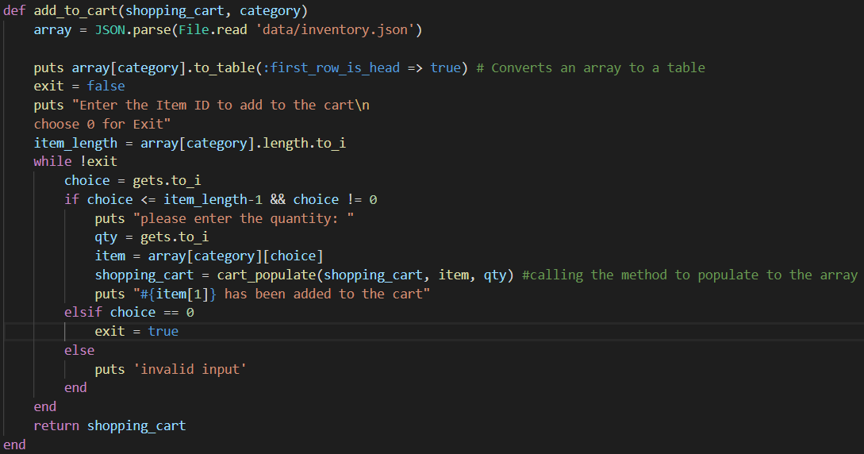
Application Structure

Slide 12
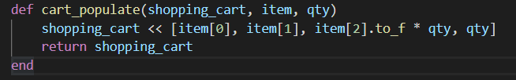
Application Structure

Slide 13
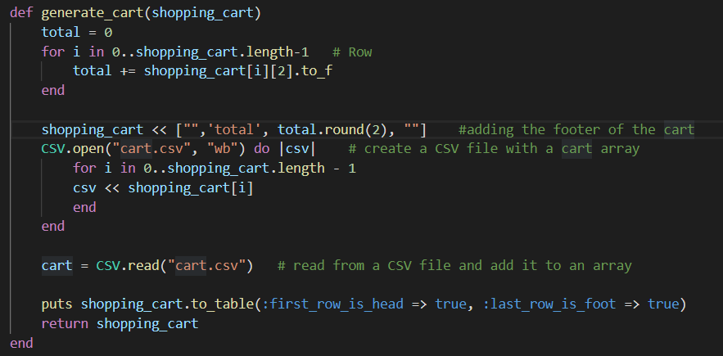
Application Structure

